Slide 1
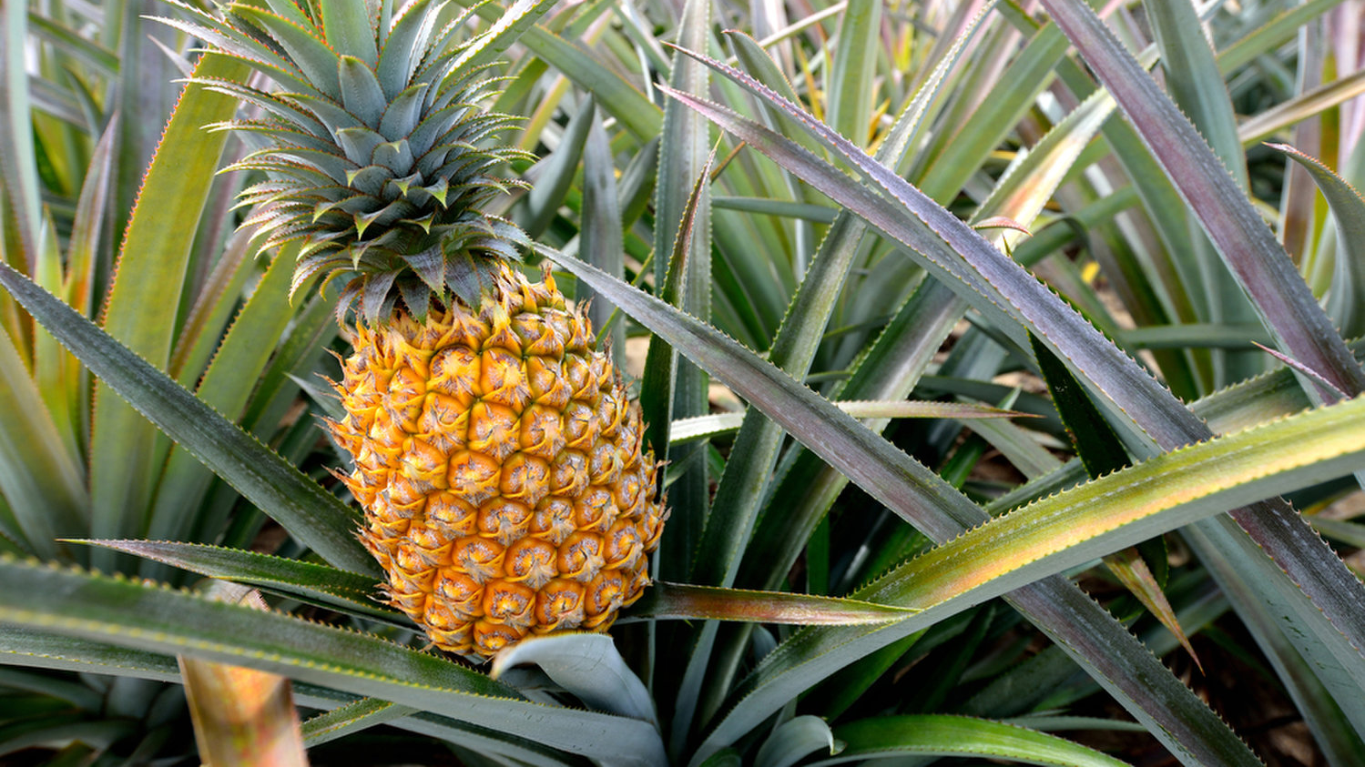
11-711 Recitation
Nikita Srivatsan
2017-10-06
Notes:
Pineapples are not a single fruit but a colony of small fruits
Number of rows of fruit is a Fibonacci number in any direction at any angle
Syntactic ambiguity---surely you must be kidding me?

Slide 2
THE FOLLOWING PREVIEW HAS BEEN APPROVED FOR
11-711 AUDIENCES
BY THE MOTION PICTURE ASSOCIATION OF AMERICA, INC.
www.filmratings.com
www.mpaa.org

Slide 3
Reminder on HMMs
Notes:
Everything you didn’t pay attention to last week actually matters

Slide 4
Reminder on HMMs
Notes:
HMMs are just right-branching trees

Slide 5
Context-Free Grammars
NP
V
ROOT
S
N
ate
S
NP
VP
NP
VP
Det
N
N
N
V
NP
Det
cake
I
the
Notes:
Previously FSA, hard to visualize for trees
Rules describe transitions, emissions, and now splits (types of rules)
Think of grammars as puzzle pieces
If the NTs match, you can attach
Like HMM transitions, conditional probability on expansion

Slide 6
The Generative Story
ROOT
S
NP
VP
N
V
NP
Det
N
I
ate
the
cake

Slide 7
Parsing
ROOT
S
NP
VP
N
V
NP
Det
N
I
ate
the
cake
Notes:
Recover parse from words (why is this hard?)

Slide 8
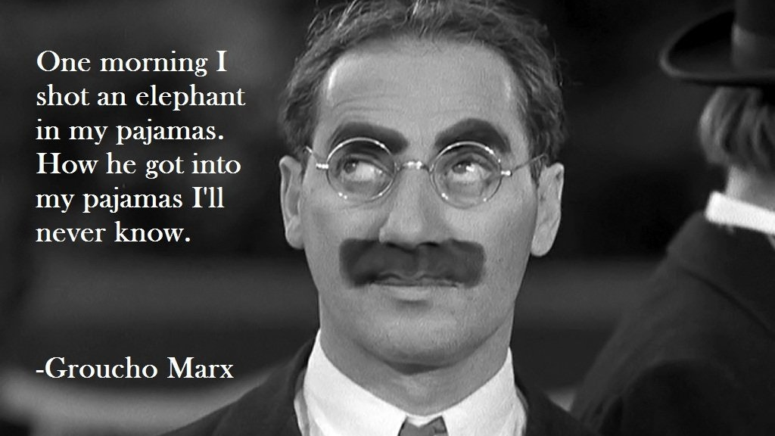
Notes:
Second sentence assumes an unlikely parse of the first

Slide 9
Viterbi – Decoding an HMM
N
N
N
N
V
V
V
V
Det
Det
Det
Det
JJ
JJ
JJ
JJ
Notes:
Recover most likely path with DP

Slide 10
CKY – Decoding a Tree
NP
VP
PP
S
NP
VP
PP
S
NP
VP
PP
S
Notes:
This trellis is hard to visualize, so we use a chart
Note that this is more analogous to the backward algorithm than the forward

Slide 11
The Chart
0
1
2
3
4
Notes:
Denote possible locations for nonterminals
Each cell can contain as many elements as there are nonterminals
Index chart with spans

Slide 12
The Chart
S
VP
NP
NP
V
Det
N
I
ate
the
cake

Slide 13
The Chart
S
VP
NP
NP
V
Det
N
0
1
2
3
4
I
ate
the
cake
Notes:
What about unary rules?
Spans combine to form larger spans (chalkboard)

Slide 14
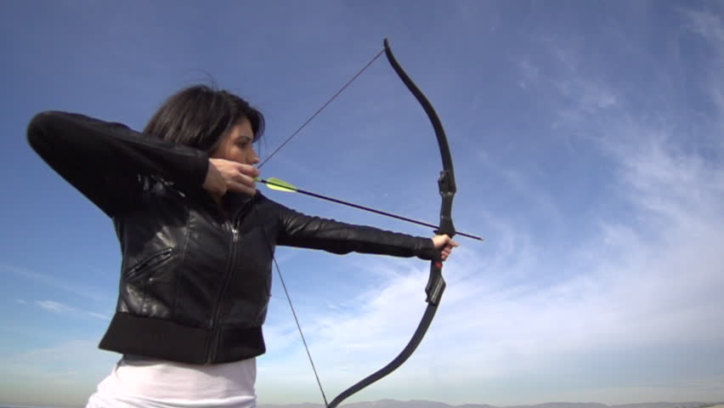
“Time flies like an arrow”

Slide 15
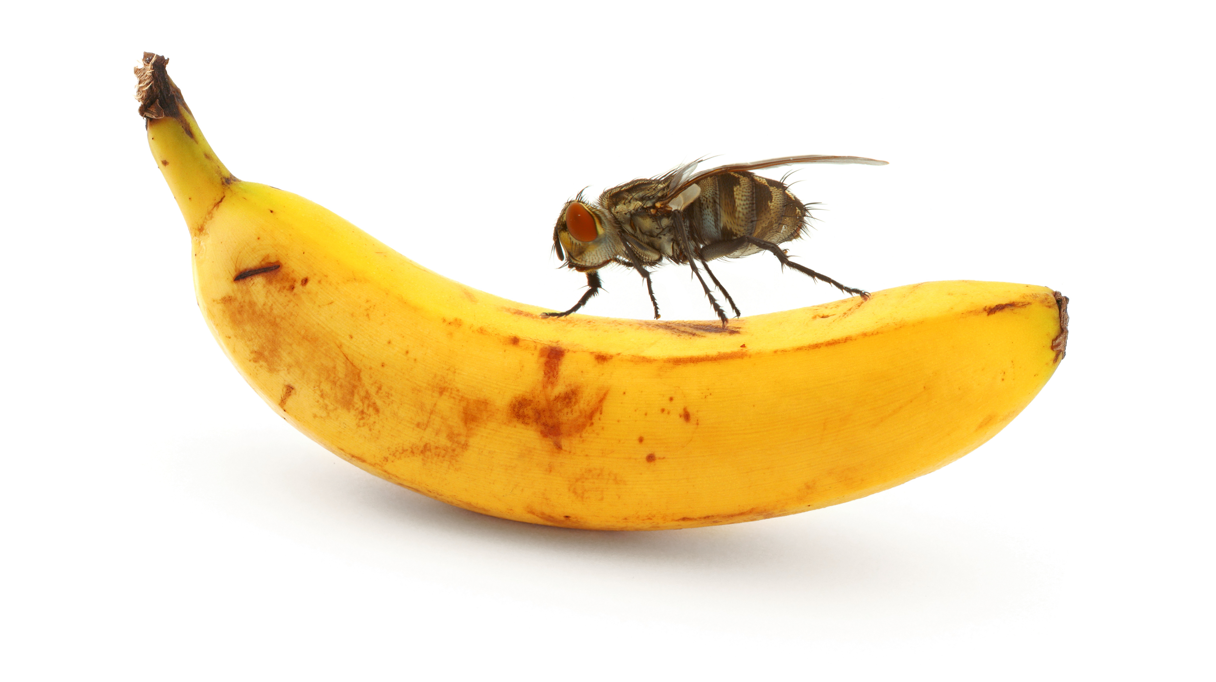
“Fruit flies like a banana”

Slide 16
Parsing with CKY
PCFG Rules
1 : NP -> Det N
3 : VP -> V NP
2 : PP -> P NP
2 : VP -> VP PP
1 : S -> NP VP
3 : NP -> NP NP
1 : NP -> time
3 : NP -> flies
2 : VP -> flies
3 : V -> like
2 : P -> like
1 : Det -> an
1 : N -> arrow
17 S
13 S
13 S
11 VP
9 VP
7 PP
7 NP
4 S
3 NP
3 NP
3 V
1 NP
1 Det
1 N
2 VP
2 P
0
1
2
3
4
5
time
flies
like
an
arrow
Notes:
Cells are roughly equivalent to time steps in HMM
Use negative log prob
Most likely path given by most likely of local decisions
Get a redundancy at top of tree – only keep most likely

